Slide 1
Positioning Using Time-Difference of Arrival Measurements
Abhinav-201431218
Srinivas-201431226

Slide 2
Abstract :
This presentation describes - Positioning using time-difference of arrival measurements and solving algorithms/techniques.

Slide 3
Overview :
In this we discuss about hyperbolic position location estimator with TDOA’s from four stations.

Slide 4
Overview :
Time Difference of Arrival(TDOA) is an electronic technique used in direction finding and navigation, in which the time of arrival of a specific signal, at physically separate receiving stations with precisely synchronized time references, are calculated and estimated.

Slide 5
Why Hyperbolic ?
Multilateration(MLAT) - navigation technique - difference in distance to two stations at known locations. (also known as hyperbolic navigation)
When these possible locations are plotted - hyperbolic curve.
To locate the exact location along that curve, multilateration relies on multiple measurements - a second measurement taken to a different pair of stations will produce a second curve - which intersects with the first.
When the two curves are compared, a small no.of possible locations are produced - to a fix location - precise.

Slide 6
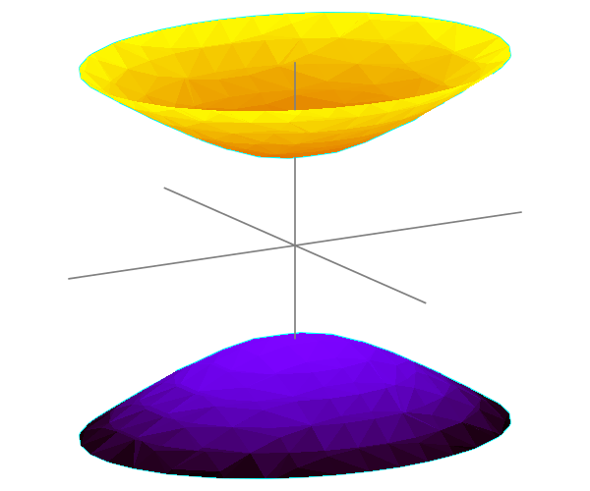
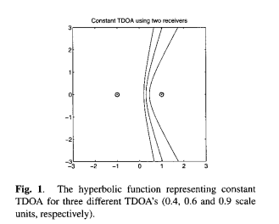
How ??
With two receivers at known locations, and a known TDOA, the no.of possible emitter locations is one half of a two-sheeted hyperboloid.
The receivers do not need to know the absolute time at which the pulse was transmitted - only the time difference is needed.
A two-sheeted Hyperboloid
R1 and R2 locations of receivers and S is source.
TDOA = t1- t2 = known.
v(t1 - t2) = constant = vt1 - vt2
=> R1S - R2S = constant
=> locus of S is hyperbola with R1 and R2
are foci.

Slide 7
Description :
In this hyperbolic position location technique, it uses cross-correlation of received signals, to estimate TDOA of propagating signal received at two receivers.
This delay measurement defines a hyperbola of constant range difference from receivers which are located at foci.
Intersection of all such hyperbolas or hyperboloids gives source location.

Slide 8
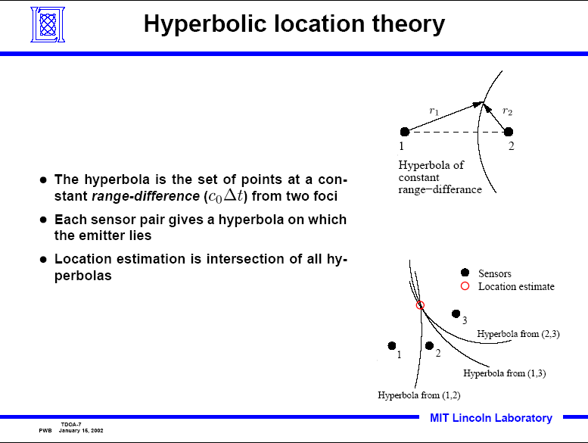
Hyperbolic location theory :

Slide 9

Procedure :
We know the TDOA of signal from source to receiver
TDOA = t1 - t2 = known = constant
C = propagation speed of signal (usually speed of light as it is RF signal)
=> t1C - t2C = constant
t1C is distance between R1 and S(ource) and t2C is distance between R2 and S.
=> R1S - R2S = constant
=> locus of S is hyperbola with R1 and R2 as foci.
In this we take 4 receivers/stations and estimate exact location of Source. So we get 3 such hyperbolas.
Pair of receivers gives hyperbolic equation.
If location of S(x,y,z) and Ri location is Ri(Xi, Yi, Zi), then

Slide 10
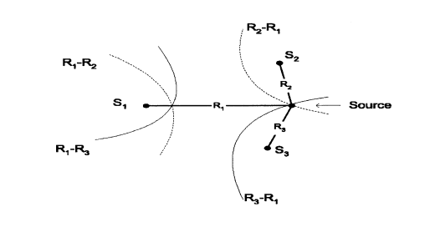
Procedure :
Here we get hyperbolic equations for 3 receivers R1, R2 and R3.
The adjacent figure shows the formation of 2 hyperbolas with 3 receivers
Their intersection shows the location of source(S)
In this all the receivers are co-planar(all in same plane), so 2 or more hyperbolas are enough to get location of source. Example is shown.
To get 3D precise location of source we need at least 3 hyperbolas => at least 4 receivers.
Two dimensional hyperbolic position location solution

Slide 11
Algorithms :
We have 4 receivers., let’s take them R1 and Ri, Rj, Rk., R1 is the first receiver to get the signal from source and i,j,k are other three.
We know Ri = √(Xi−x)2+(Yi−y)2+(Zi−z)2
Ri,1 = C*di,1 = Ri - R1 = (√(Xi−x)2+(Yi−y)2+(Zi−z)2 ) - (√(X1−x)2+(Y1−y)2+(Z1−z)2)
Here C = 3*10^8 m/s.(as they are normal RF signals.)
From above we get 3 expressions, Ri1, Rj1, Rk1., These 3 are non-linear equations and very difficult to solve in a direct way.

Slide 12
...
We need to linearize these non-linear equations as they are difficult to solve by mathematical ways. Many algorithms were proposed to ease the solving of these equations turning them to linear equations.
Few proposed algorithms were:
Taylor-series method : using taylor-series expansion we can make that non-linear equation to linear, but it increases error in estimating the precise location
Fang’s method : Assume first base station to be at (0,0,0) and make other station to be at (x,0,z) and solve by changing the axis, but it doesn’t provide a better way to solve when there are many stations.
Chan’s method : useful when the error in TDOA is minimum., can solve it in O(nlogn) time., used for solving those equations.

Slide 13
Derivation of Algorithm/solving equations :
Includes solving those non-linear system of equations. We got C*ti = Ri., C*tj=Rj., C*tk = Rk. And Ri-Rj=Rij., Rik= Ri-Rk., Rkj= Rk-Rj., Rkl= Rk-Rl. Here we took Ri,Rj,Rk are receivers on earth and Rl as GPS satellite for easy solving of equation. Using above four equations, we get equations by doing some math and algebra. And solving those equations we get 2 plane equations => y = Ax+Bz+C and y = Dx+Ez+F And equating those two plane equations we get, Ax+Bz+C = Dx+Ez+F => x=Gz+H From here solve for x,y,z => location of source is S(x,y,z)

Slide 14
Advantages :
One commercial application for TDOA is locating a cellular telephone based on comparing when the signal arrives at different cell towers.
The technique requires no additional circuitry in the telephone, since it uses the standard signal.
It may be supplemented with an angle of arrival information if the cell towers have directional receiving antennas.

Slide 15
Applications : (taken in location system)
Low deployment and operational cost
Initial location and location update capability
Immediate coverage for ALL mobile phones
Operates in urban, suburban and rural areas
Low to minimal requirements for standards support (related to determining location)

Slide 16
Resources used :
http://ieeexplore.ieee.org/stamp/stamp.jsp?tp=&arnumber=1201741&tag=1
http://archives.njit.edu/vol01/etd/2000s/2002/njit-etd2002-037/njit-etd2002-037.pdf

